Slide 1


The Developer and the Data Scientist
No AI has been harmed during the making of this presentation

Slide 2













Thank you to our Sponsors!

Slide 3




Emily Lynn
Data Scientist and Engineer
Slalom Consulting
emily.lynn@slalom.com
Eric Lynn
Developer and Architect
DeltaPoint Solutions
elynn@deltapointsolutions.com

Slide 4


Slide 5
Q & A
Who is here?

Slide 6

Data Science Power!

Slide 7

Data Science Power!
Hidden/Mysterious
Much more powerful than expected
Seems magical
Might be dangerous if fully unleashed!

Slide 8
Data Science Power!

Slide 9

Data Science Power!

Slide 10
What Is Developer Power?
Creating applications and systems that efficiently perform tasks
Efficiently managing data
Gaining insight from past and current state
Building automations
Connecting and communicating between systems

Slide 11

What Is Developer Power?
#1 - The Power to Build Structured Systems Out of Chaos
#2 - The Power to Build Breakthrough User Experiences

Slide 12
What Is Data Science Power!
Analyze data for valuable insights
Predict the future state of the data
Automate manual non-deterministic tasks to speed them up
Design data experiments to prove hypothesis
Work with a wide variety of data types (tables, natural language, images, etc.)

Slide 13

What Is Data Science Power?
#1 - Generalize From Specific Examples to Unseen Instances
#2 - Utilize Unstructured Data

Slide 14


Slide 15







Slide 16


Slide 17
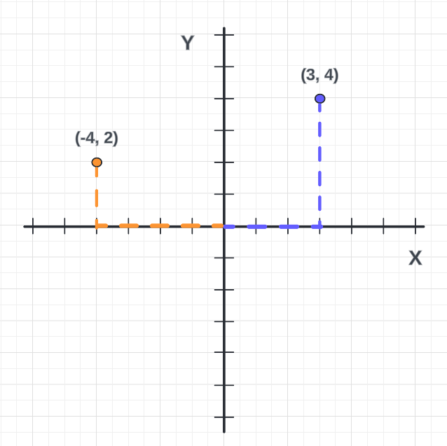

Slide 18
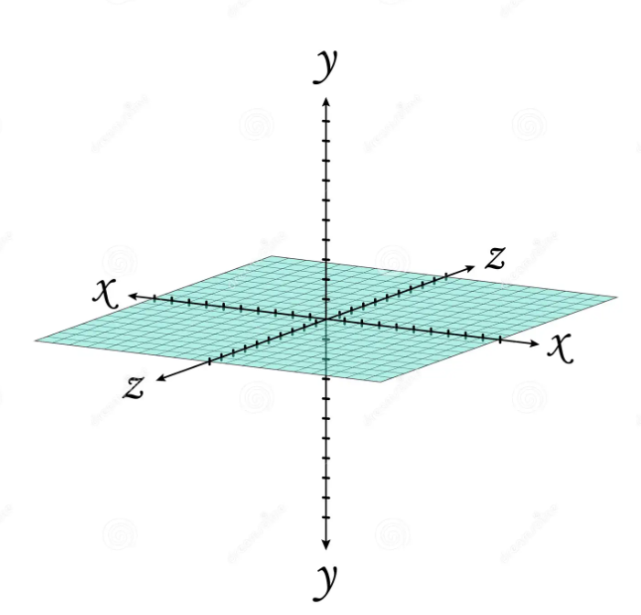

Slide 19
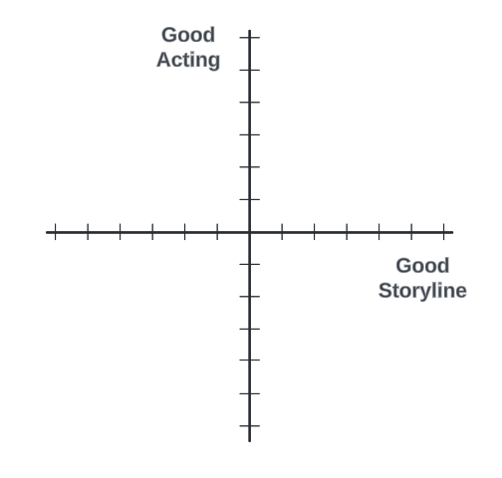

Slide 20
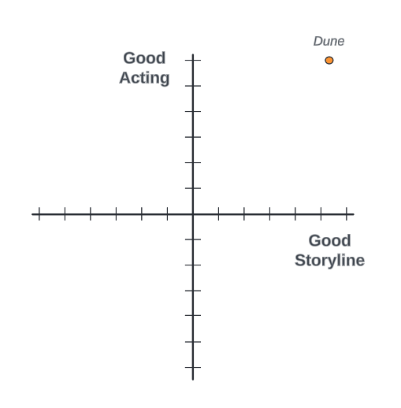

Slide 21
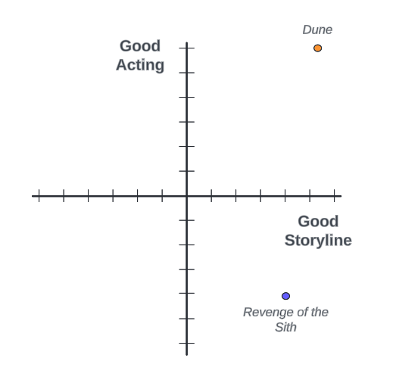

Slide 22
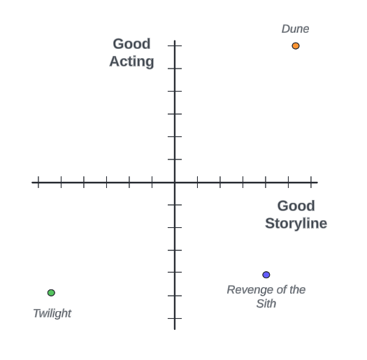

Slide 23
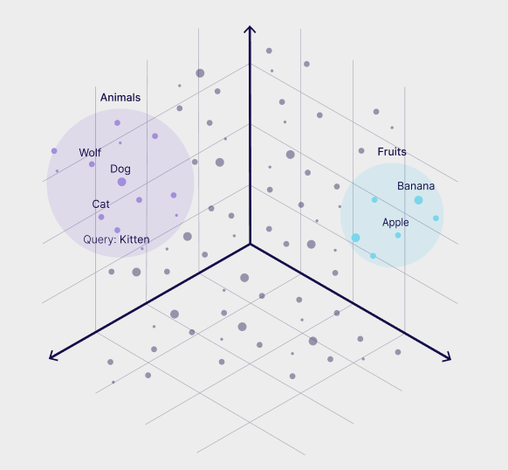
Source: https://weaviate.io/blog/hybrid-search-for-web-developers

Slide 24
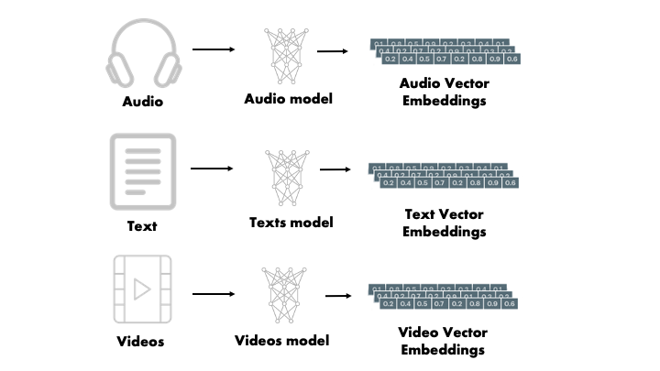
Source: https://partee.io/2022/08/11/vector-embeddings/

Slide 25
Vector Databases

Slide 26
Vectors coming to Azure SQL
--Assuming you have a stored procedure to get embeddings for a given text
DECLARE @e VARBINARY(8000);
EXEC dbo.GET_EMBEDDINGS @model = '<yourmodeldeploymentname>’,
@text = 'healthy options instead of coke’,
@embedding = @e OUTPUT;
SELECT TOP(10) ProductId,
Summary,
Text,
VECTOR_DISTANCE('cosine', @e, VectorBinary) AS Distance
FROM dbo.FineFoodReviews
ORDER BY Distance;
Source: https://devblogs.microsoft.com/azure-sql/announcing-eap-native-vector-support-in-azure-sql-database/

Slide 27

Developers Enabled with Data Science Power!
New Value
New Mindset

Slide 28
New Value
Access to a rich new set of data sources
High performance hybrid queries via vectors
New user experiences – both simpler and richer

Slide 29
New Mindset
Stop thinking of LLMs as chatbots
Be okay with non-deterministic
Consider data that was previously inaccessible

Slide 30

The Developer and the Data Scientist

Slide 31
Q & A
Q & A

Slide 32
The Developer and the Data Scientist
No AI has been harmed during the making of this presentation

Slide 33
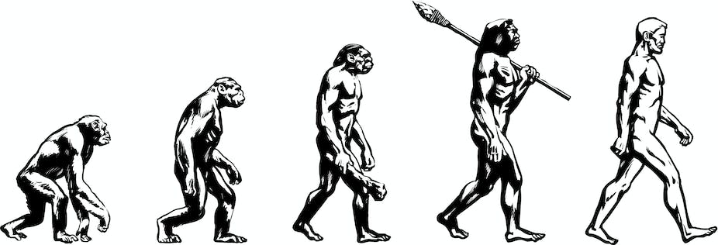
CSV
INI
XML
YAML
JSON

Slide 34

A Complete Guide to LangChain in JavaScript| by Let's Code Future | Stackademic

Slide 35

The Developer and the Data Scientist
No AI has been harmed during the making of this presentation

Slide 36
New Risks/Limitations
Privacy, security, bias, hallucinations, etc.
Managing open loops in your workflow
Using data science power is not free ($$ and time)

Slide 37
Vectors coming to Azure SQL
--Assuming you have a stored procedure to get embeddings for a given text
DECLARE @e VARBINARY(8000);
EXEC dbo.GET_EMBEDDINGS @model = '<yourmodeldeploymentname>’,
@text = 'healthy options instead of coke’,
@embedding = @e OUTPUT;
SELECT TOP(10) ProductId,
Summary,
Text,
VECTOR_DISTANCE('cosine', @e, VectorBinary)
AS Distance
FROM dbo.FineFoodReviews ORDER BY Distance;
Source: https://devblogs.microsoft.com/azure-sql/announcing-eap-native-vector-support-in-azure-sql-database/

Slide 38
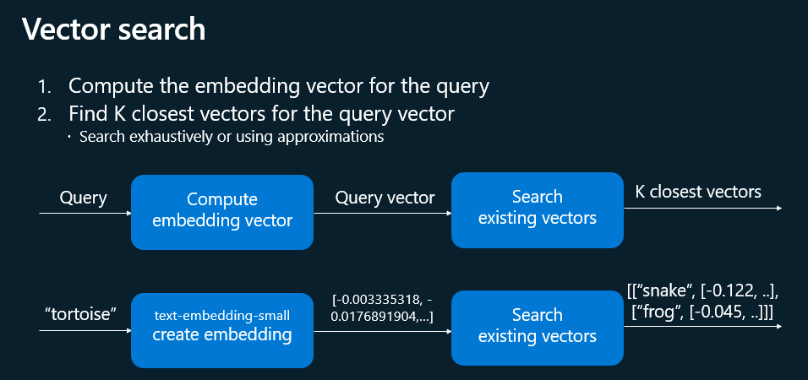
Vectors coming to Azure SQL
Source: https://devblogs.microsoft.com/azure-sql/announcing-eap-native-vector-support-in-azure-sql-database/

Slide 39
